Slide 1
The Click ARPQuerier
Demystified by Bart Braem

Slide 2



The scenario
ping
pong

Slide 3
What really happens
What is the L2 address of 10.0.0.2?
I’d like to ping 10.0.0.2
What is the L2 address of 10.0.0.1?
I’d like to pong 10.0.0.1
ARP Req
Who has 10.0.0.2
ARP Reply
10.0.0.1 is at ...
ARP Req
Who has 10.0.0.1
ARP Reply
10.0.0.2 is at ...
ping
pong

Slide 4
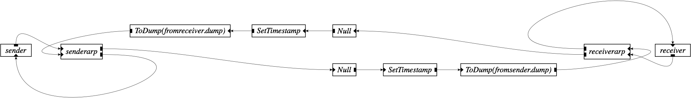
And in Click
ARP Req
Who has 10.0.0.1
ARP Reply
10.0.0.2 is at ...
pong
ARP Req
Who has 10.0.0.2
ARP Reply
10.0.0.1 is at ...
ping

